Slide 1

CSE- 208
Algorithm Lab
Lab: 02
Fahad Ahmed
Lecturer, Dept. of CSE
E-mail: fahadahmed@uap-bd.edu

Slide 2
Algorithm Complexity Analysis
Write a C program find a number is prime or not.

Slide 3
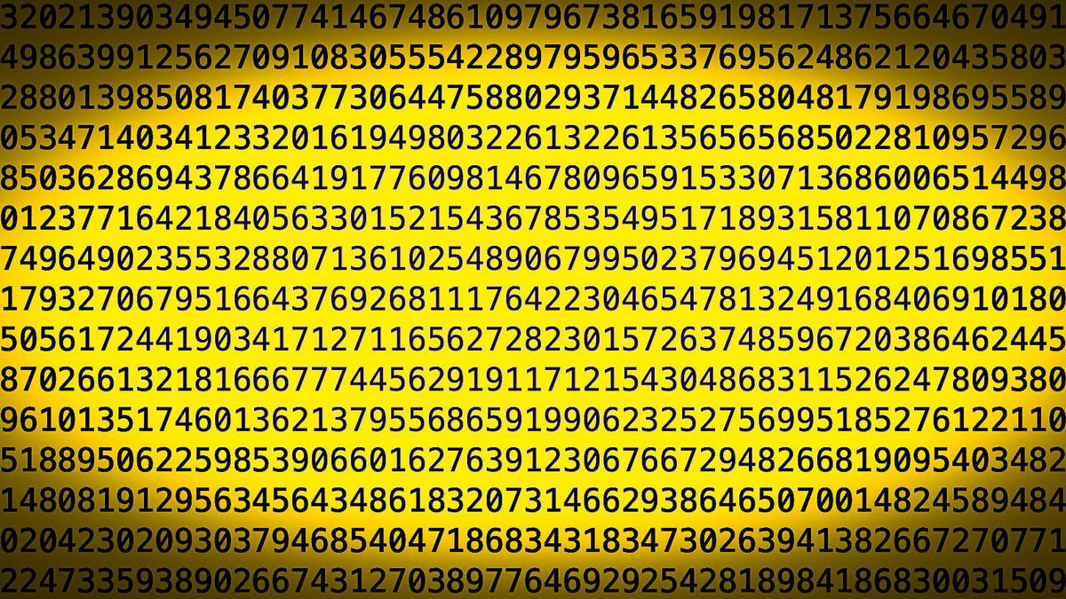
Algorithm Complexity Analysis
Solution -1:
A prime number is a natural number greater than 1, which is only divisible by 1 and itself. (Divisor==2)
The newly found number has 23,249,425 digits, nearly one million digits

Slide 4
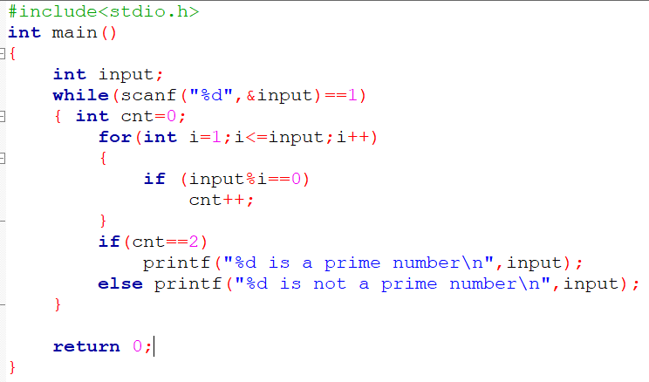
Algorithm Complexity Analysis
Solution -1:
A prime number is a natural number greater than 1, which is only divisible by 1 and itself.

Slide 5
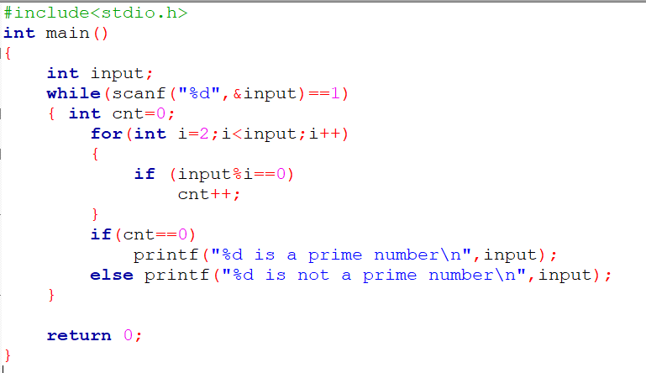
Algorithm Complexity Analysis
Solution -2:
A prime number is a natural number greater than 1, which is only divisible by 1 and itself.

Slide 6
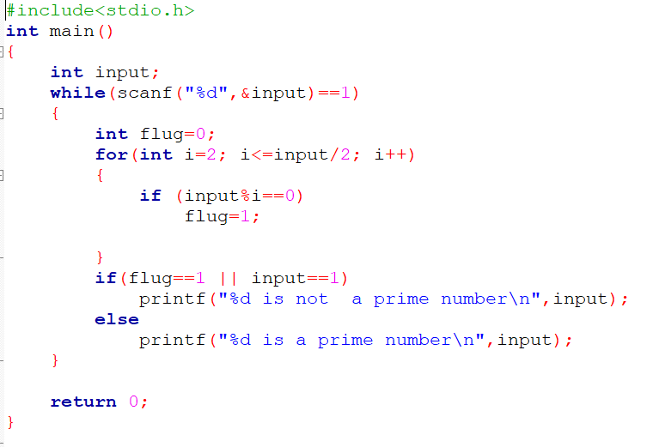
Algorithm Complexity Analysis
Solution -3: Check up to N/2

Slide 7
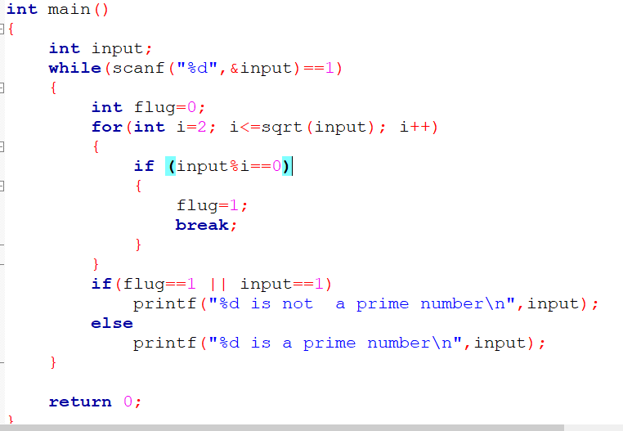
Algorithm Complexity Analysis
Solution -4: Check up to square root N

Slide 8
Algorithm Complexity Analysis
Solution -5:
Wilson Theorem: Wilson’s theorem states that a natural number p > 1 is a prime number if and only if
(p - 1) ! ≡ -1 mod p
OR
(p - 1) ! ≡ (p-1) mod p

Slide 9
Algorithm Complexity Analysis
Algorithms to find all prime numbers smaller than the N.
Sieve of Eratosthenes
Segmented Sieve
Sieve of Sundaram
Bitwise Sieve
We can modify the algorithm in a such a way, that it only has linear time complexity. This approach is named Linear Sieve.

Slide 10
Sieve of Eratosthenes
Solution -6: The time complexity of this algorithm is O(n log log n)

Slide 11
Practice Problems
Practice Problems (Optional)
SPOJ - Printing Some Primes
SPOJ - A Conjecture of Paul Erdos
SPOJ - Primal Fear
SPOJ - Primes Triangle (I)
Codeforces - Almost Prime
Codeforces - Sherlock And His Girlfriend
SPOJ - Namit in Trouble
SPOJ - Bazinga!
Project Euler - Prime pair connection
SPOJ - N-Factorful
SPOJ - Binary Sequence of Prime Numbers
UVA 11353 - A Different Kind of Sorting
SPOJ - Prime Generator
SPOJ - Printing some primes (hard)
Codeforces - Nodbach Problem
Codefoces - Colliders

Slide 12

Thanks to All

